Slide 1
JAVA SPRING BOOT MICROSERVICES
UNIQUE
SOWJANYA MORISETTY
YASHWANTH RAVULA
MEGHANA BAREDDY
RAYONA MATHEW

Slide 2
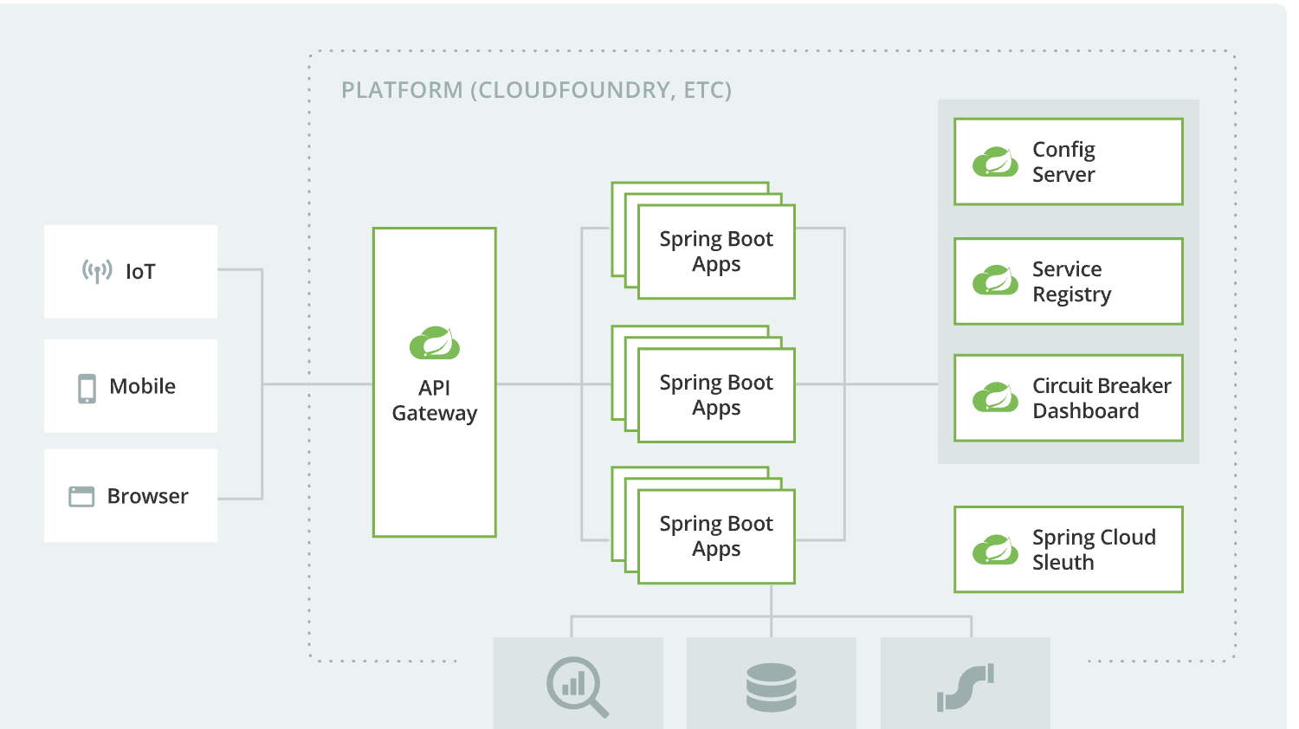

Slide 3
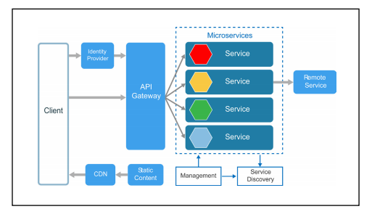

Slide 4
MICROSERVICES
Microservices are small, independent services that work together to form a larger application.
They are loosely coupled and independently deployable, which makes them highly scalable and adaptable to changing business requirements.

Slide 5
Principles of Microservices
There are the following principles of Microservices:
Single Responsibility principle
Modelled around business domain
Isolate Failure
Infrastructure automation
Deploy independently

Slide 6
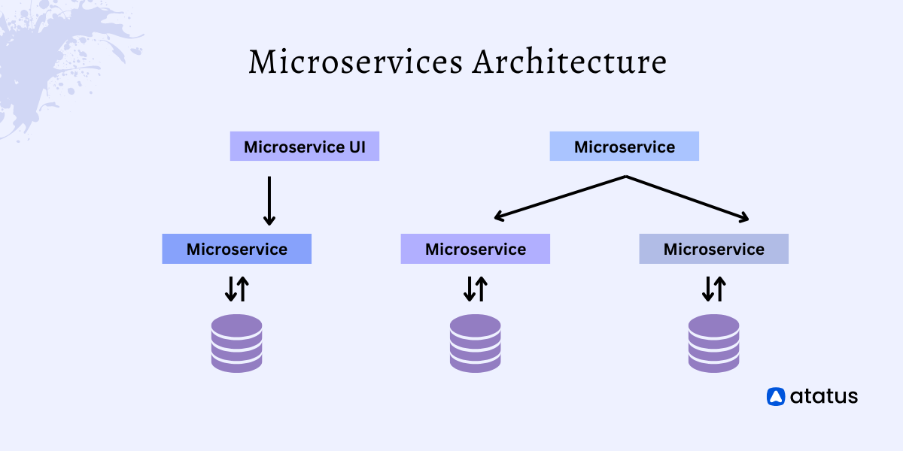

Slide 7
EUREKA SERVER
Eureka Server is a service registry that helps in registering and discovering microservices.
It keeps track of all the running instances of each microservice, and when a client needs to communicate with a microservice, it looks up the available instances and routes the request to the appropriate one.

Slide 8
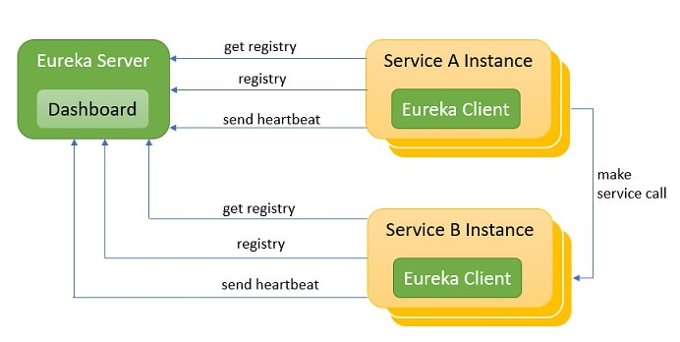

Slide 9
SPRING CLOUD GATEWAY
Spring Cloud Gateway is a powerful tool that provides essential features such as load balancing, request routing, and circuit breaking.
It acts as a reverse proxy that sits in front of the microservices and routes requests based on configurable rules.

Slide 10
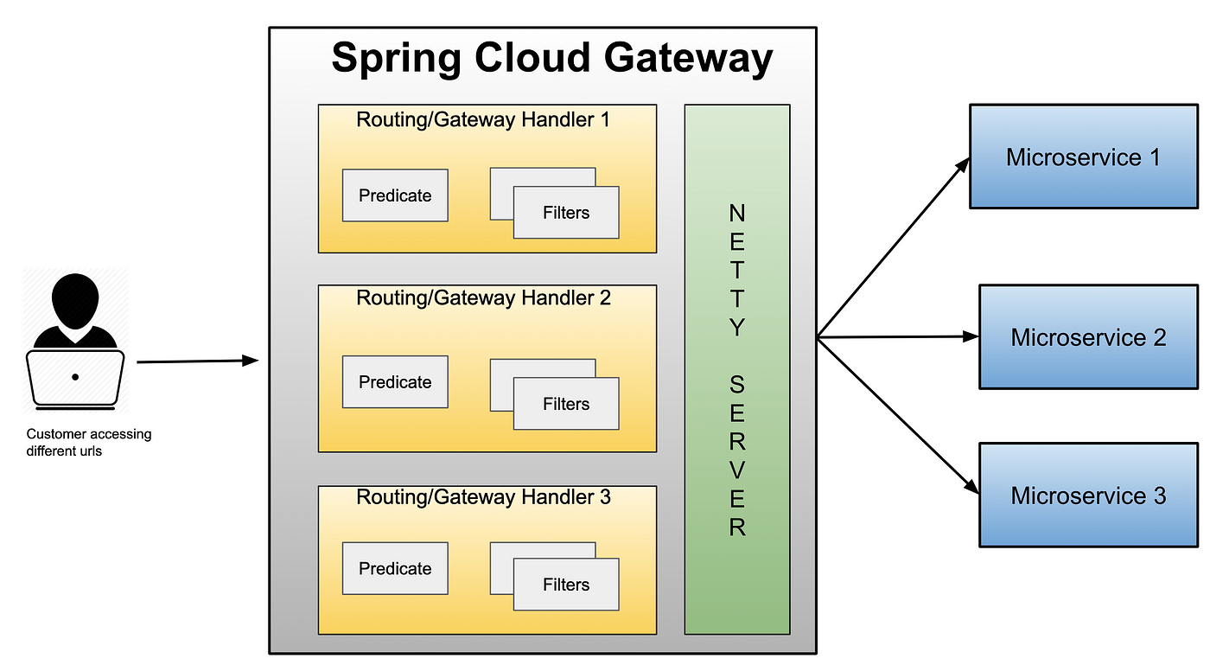

Slide 11
COMMUNICATION BETWEEN SERVICES
Microservices can communicate with each other using RESTful HTTP APIs, gRPC, or message queues like RabbitMQ.
RESTful APIs are easy to use and widely supported, whereas gRPC offers faster communication and is optimized for large-scale systems. Message queues are ideal for asynchronous communication, which enables loose coupling between microservices.

Slide 12
SYNCHRONOUS vs ASYNCHRONOUS
Synchronous communication is a request-response approach in which a sender sends a request and waits for a response, whereas asynchronous communication is a message-passing approach in which a sender sends a message without waiting for a response.
Synchronous communication is simpler to implement, but it can lead to performance issues if there are many requests. Asynchronous communication is more complex but enables more scalable and fault-tolerant systems.

Slide 13
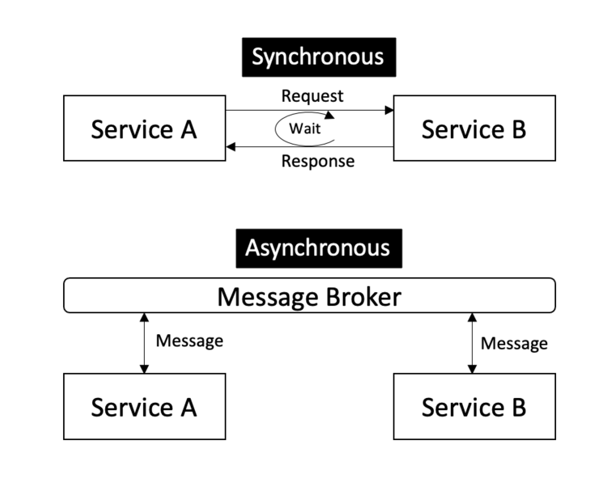

Slide 14
Synchronous Way
REST Template
REST Template is the easiest way to establish synchronous communication from m1 to m2.
RestTemplate is a class available under spring.framework.web.client that acts as a synchronous client to perform HTTP requests.

Slide 15
Feign
Feign requires additional configuration across both services if you want to go by this way.
This approach uses standard Java interfaces.
Addition perks of using feign over rest-template is that you don’t get to hard-code your URL here.
Eureka Client ID can also be used for server-discovery purposes in order to establish communication.

Slide 16
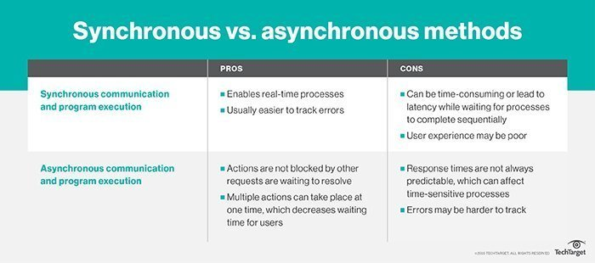

Slide 17
Asynchronous Way
One possible asynchronous way to establish communication is by using a message broker. Let’s understand the use-case first.
It behaves as an intermediary service between m1 and m2.
When m1 has to communicate with m2, m1 would push a message to the broker instead of directly sending it to the m2.
Depending on the broker’s type the message will be conveyed to the listener of m2 and action would be taken accordingly.

Slide 18
ZIPKIN DISTRIBUTION
Zipkin Distributed Tracing is an open-source project that provides distributed tracing for microservices architecture.
It helps in troubleshooting and debugging by tracing the entire request chain, from the initial client request to the final microservice response.

Slide 19
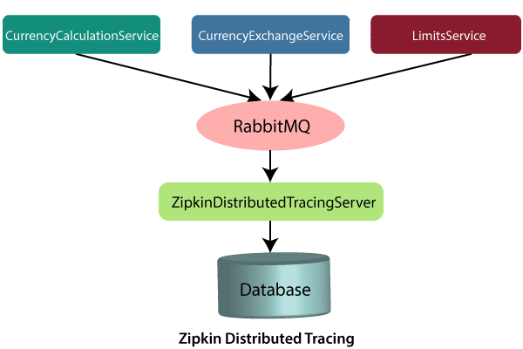

Slide 20
ARCHITECTURE
The overall architecture consists of multiple microservices that communicate with each other through APIs, with the help of service registries like Eureka Server and API gateways like Spring Cloud Gateway.
The microservices are often deployed on cloud infrastructure and are managed through container orchestration platforms like Kubernetes.
The architecture also includes tools like Zipkin Distributed Tracing and Config Server that help in troubleshooting, monitoring, and managing the system.

Slide 21
CONFIG SERVER
Config Server is a centralized server that stores configuration files for all the microservices in the architecture.
These configuration files include properties such as database URLs, security settings, and feature flags.
Microservices can fetch these configuration files from the Config Server at runtime, which makes it easy to make changes to the configuration without having to redeploy the microservices.

Slide 22
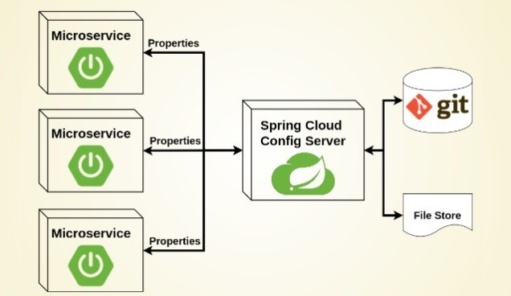

Slide 23
ACTUATOR
Actuator is a tool that helps in monitoring and managing microservices at runtime.
It provides endpoints that expose information about the microservice, such as health, metrics, and configuration.
This information can be accessed through HTTP requests, which makes it easy to monitor the microservice and detect issues.

Slide 24
There are three main features of Spring Boot Actuator:
Endpoints
Metrics
Audit

Slide 25
Endpoint
The actuator endpoints allows us to monitor and interact with the application. Spring Boot provides a number of built-in endpoints.
We can also create our own endpoint. We can enable and disable each endpoint individually.
Most of the application choose HTTP, where the Id of the endpoint, along with the prefix of /actuator, is mapped to a URL.
For example, the /health endpoint provides the basic health information of an application. The actuator, by default, mapped it to /actuator/health.

Slide 26
Metrics
Spring Boot Actuator provides dimensional metrics by integrating with the micrometer. The micrometer is integrated into Spring Boot.
It is the instrumentation library powering the delivery of application metrics from Spring.
It provides vendor-neutral interfaces for timers, gauges, counters, distribution summaries, and long task timers with a dimensional data model.

Slide 27
Audit
Spring Boot provides a flexible audit framework that publishes events to an AuditEventRepository.
It automatically publishes the authentication events if spring-security is in execution.

Slide 28
SWAGGER
Swagger is a tool that helps in documenting and testing APIs.
It provides a user-friendly interface that displays all the available endpoints, their parameters, and their responses.
Developers can use Swagger to test the APIs and generate code snippets in multiple programming languages.

Slide 29
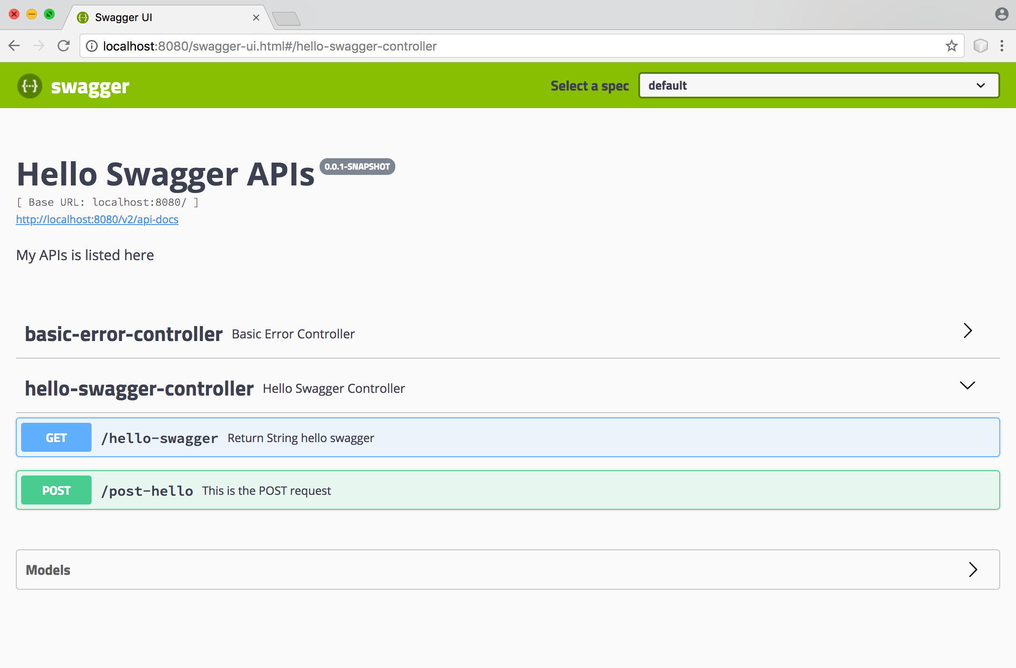

Slide 30
Advantages of Microservices
Microservices are self-contained, independent deployment module.
Microservices follows the single responsibility principle.
It is possible to change or upgrade each service individually rather than upgrading in the entire application.
The demanding service can be deployed on multiple servers to enhance performance.
Microservices are independently manageable services. It can enable more and more services as the need arises. It minimizes the impact on existing service.

Slide 31
Disadvantages of Microservices
Microservices has all the associated complexities of the distributed system.
There is a higher chance of failure during communication between different services.
Difficult to manage a large number of services.
The developer needs to solve the problem, such as network latency and load balancing.
Complex testing over a distributed environment.

Slide 32
Microservices vs Monolithic
Monolithic architecture is built as one large system and is usually one code-base.
It is not easy to scale based on demand.
It has shared database.
Large code base makes IDE slow and build time gets increase.
It extremely difficult to change technology or language or framework because everything is tightly coupled and depend on each other

